Slide 1
TAK Server - Federation Hub

Slide 2


TAK Server – Federation Hub Installation
You should have your TAK Server already installed and running.
Download Federation Hub from the following link:
https://tak.gov/products/tak-server
Update package manager:
sudo yum update –y
Ensure you are running Java version 17:
java --version
To install java 17:
sudo dnf install java-17-openjdk-devel –y

Slide 3
TAK Server – Federation Hub Installation
Copy the Federation Hub file over to the server:
On your local machines terminal:
scp takserver-fed-hub-*.rpm <username>@<IP address>:~/
Example: scp takserver-fed-hub.*.rpm takadmin@192.168.1.123:~/
You can use the entire file name if you have multiple versions downloaded.
Install the RPM:
sudo dnf install takserver-fed-hub-*.noarch.rpm -y
Add and Apply SELinux:
sudo dnf install checkpolicy
cd /opt/tak/federation-hub && sudo ./apply-selinux.sh && sudo semodule –l | grep takserver
Notes:
# RPM = red hat package manager

Slide 4

TAK Server – Federation Hub Installation
Add database credentials (otherwise the default will be generated):
Open the federation hub broker file as the tak bash user:
sudo su tak
vim /opt/tak/federation-hub/configs/federation-hub-broker.yml
Scroll down to “dbPassword” and enter in a valid password:
Optionally install Mongo: (cannot be done as the bash user “exit”)
sudo cp /opt/tak/federation-hub/scripts/db/mongodb-org.repo /etc/yum.repos.d/mongodb-org.repo sudo yum install -y mongodb-org sudo systemctl daemon-reload sudo systemctl enable mongod sudo systemctl restart mongod sudo /opt/tak/federation-hub/scripts/db/configure.sh
Notes:
# Mongo is a document database that makes it easy for developers to store structured and unstructured data.
# If trying to make changes to the document and you can't save the changes open it with sudo

Slide 5
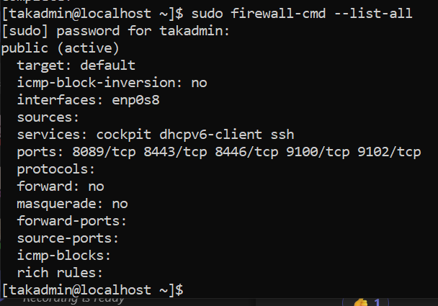
TAK Server – Federation Hub Firewall Configuration
Configure the necessary ports:
sudo firewall-cmd --zone=public --add-port 9100/tcp --permanent
sudo firewall-cmd --zone=public --add-port 9102/tcp --permanent
sudo firewall-cmd --reload
You can view the current port configurations by running the following:
sudo firewall-cmd --list-all
Notes:
Port 9100 is used to connect to the admin dashboard through a browser.
Port 9102 is used to connect a TAK server to the federation hub.

Slide 6
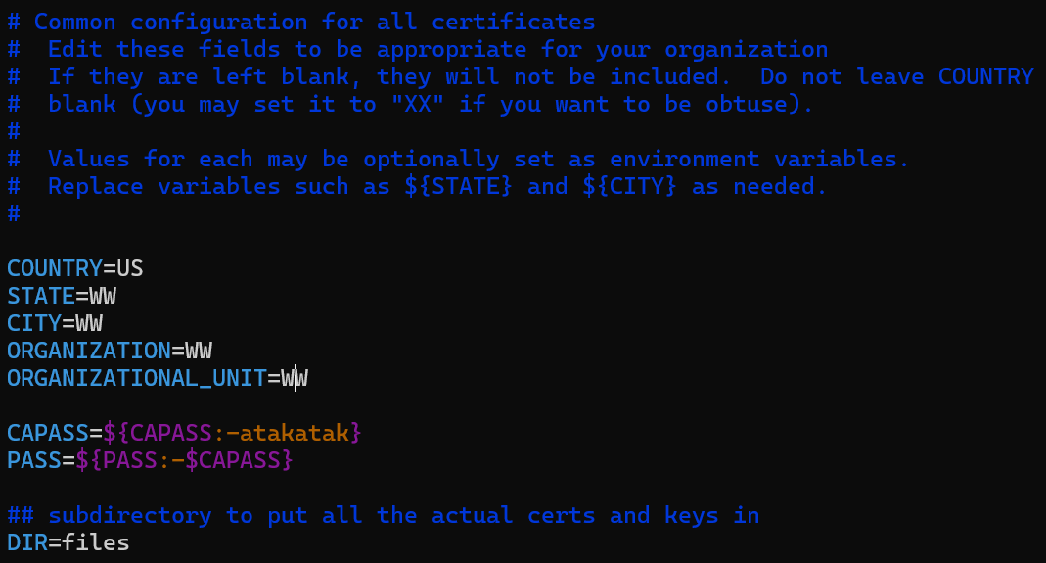
TAK Server – Federation Hub Configuration
Create your certificates:
Switch to the tak bash user:
sudo su tak
Navigate to the cert directory:
cd /opt/tak/federation-hub/certs
Modify the meta data file:
vim cert-metadata.sh
Update the values for the following:
COUNTRY: XX
STATE: XX
CITY: XX
ORGANIZATION: XX
ORGANIZATIONALUNIT: XX
Save and exit: press esc
type: :wq!
press enter
Notes:
#Ensure the path is correct for your file locations.

Slide 7
TAK Server – Federation Hub Configuration
Create the certificates needed for federation hub:
Create the root certificate:
./makeRootCa.sh --ca-name <name>
Example: ./makeRootCa.sh --ca-name truststore-root
Create the server certificate:
./makeCert.sh server <name>
Example: ./makeCert.sh server takserver
Notes:
#Ensure the path is correct for your file locations.

Slide 8
TAK Server – Federation Hub Configuration
Verify and update the file paths for the certificates:
Switch to the tak bash user:
sudo su tak
Update the path for the root certificate file if not the default (truststore-root):
sed -i 's/truststore-root/truststore-<CACommonName>/g' /opt/tak/CoreConfig.example.xml
Example: sed -i 's/truststore-root/truststore-ROOT-CA-01/g' /opt/tak/federation-hub/configs/federation-hub-ui.yml
Update both of the paths for the server certificate file if not the default (takserver):
sed -i 's/takserver/<TAKServerName>/g' /opt/tak/federation-hub/configs/federation-hub-broker.yml
sed -i 's/takserver/<TAKServerName>/g' /opt/tak/federation-hub/configs/federation-hub-ui.yml
Notes:
#Ensure the path is correct for your file locations.
#You can ensure the name of the files by navigating to the certificate's files
#cd /opt/tak/federation-hub/certs/files

Slide 9
TAK Server - Federation Hub - Configuring Authorized Users
By default, authorized users are written to /opt/tak/federation-hub/authroized_users.yml but can be written to an alternative location by running the following:
java -jar /opt/tak/federation-hub/jars/federation-hub-manager.jar <path to certs>/cert.pem <path>/authorized_users.yml
Note: If you change the location of where the file is saved you will also need to update this location within the admin UI microservice:
/opt/tak/federation-hub/configs/federation-hub-ui.yml

Slide 10
TAK Server - Federation Hub - Configuring Authorized Users
Federation hub authenticates clients using TLS (Transport Layer Security) with X509 client certificates.
If you need to create a new certificate you can run the following first:
sudo su tak
cd /opt/tak/federation-hub/certs
./makeCert.sh client admin
To authorize clients to act as administrators and enable access to the admin UI run the following:
sudo su tak
java -jar /opt/tak/federation-hub/jars/federation-hub-manager.jar <path to certs>/cert.pem
Example: java -jar /opt/tak/federation-hub/jars/federation-hub-manager.jar /opt/tak/federation-hub/certs/files/admin.pem
exit

Slide 11
TAK Server – Federation Hub Startup
Start and enable the system service:
sudo systemctl daemon-reload
sudo systemctl restart federation-hub
sudo systemctl enable federation-hub
You can also stop the service by running the following:
sudo systemctl stop federation-hub

Slide 12
TAK Server - Federation Hub - Configuring Authorized Users
Downloading admin certificate:
Ensure you are not in the tak user anymore:
exit
Return to the home directory:
cd ~
Copy the user certificate to your home directory:
sudo cp -v /opt/tak/federation-hub/certs/files/<name>.p12 .
Example: sudo cp -v /opt/tak/federation-hub/certs/files/admin.p12 .
Change the ownership to our Linux user
sudo chown -R <username>:<usergroup> /home/<username>
Example: sudo chown -R takadmin:takadmin /home/takadmin
Download the certificate to our local machine:
From a new terminal on our local machine run the following:
scp <username>@<ipaddress>:~/<user>.p12 .
Example: scp takadmin@192.168.76.246:~/admin.p12 .

Slide 13
TAK Server - Federation Hub - Configuring Authorized Users
Import the user certificate into your browser of choice:
Open chrome/edge and navigate to the browser settings.
Search for “Manage Certificates” and select the setting.
Select “Import” → Select “Next”.
Select Browse and navigate to the downloaded certificate.
Open the certificate → Select “Next”.
Enter the password: default if “atakatak”.
Select “Next” → Select “Next” → Select “Finish”

Slide 14
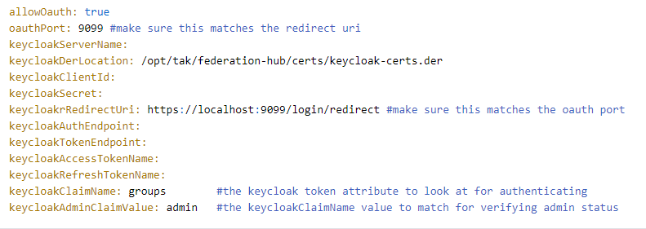
TAK Server - Federation Hub - Keycloak
Federation Hub supports Oauth admin authentication using keycloak, which can be configured by adding the following to the federation-hub-ui.yaml file:
vim /opt/tak/federation-hub/configs/federation-hub-ui.yml

Slide 15
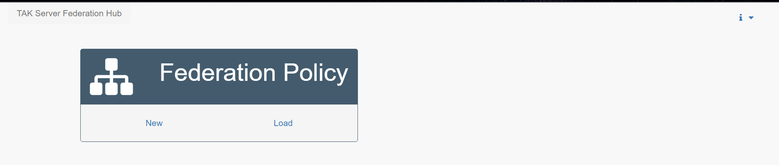
TAK Server - Federation Hub - How to Use
In a web browser navigate to https://<server ip>:9100 (you can also use “localhost” is you are accessing this from the server).
Example: https://192.168.76.246:9100
To authenticate to the Federation Hub, you should be using the same certificate that was authorized in the “Configuring Authorized Users” section.
When you successfully connect you will see the following page:

Slide 16
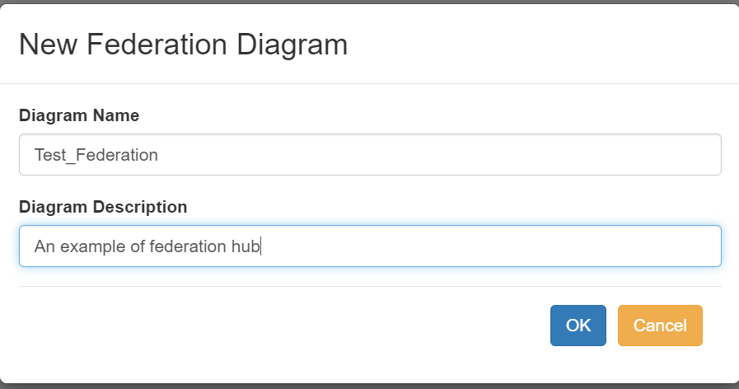
TAK Server - Federation Hub - How to Use
Select “New” and fill in the required information.
Select “OK” when done.

Slide 17
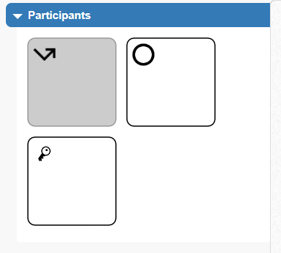
TAK Server - Federation Hub - How to Use
Adding CA Groups:
Add a CA (Certificate Authority) to the empty policy, this will be the CA of a TAK Server that we want to connect to the Federation Hub.
To do this we will need the ca.pem file form the TAK Server:
From the server: sudo cp -v /opt/tak/certs/files/ca.pem .
sudo chown -R takadmin:takadmin /home/takadmin
From your local machine: scp takadmin@192.168.1.123:~/ca.pem .
You can also copy the file from you local machine by running the following:
scp takadmin@192.168.1.123:/opt/tak/certs/files/ca.pem .
In the Federation Hub editor drag and drop the group icon to the canvas:

Slide 18
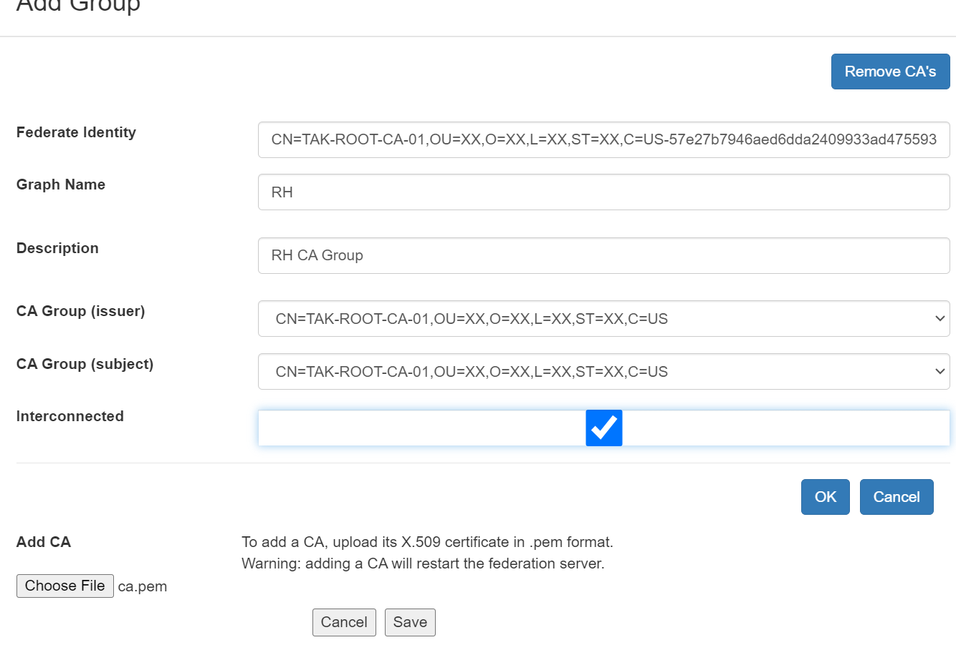
TAK Server - Federation Hub - How to Use
In the form that popped up, fill in the following:
Select “Browse” and select the ca.pem file you copied over from the TAK Server.
Once selected press “Save”
Select the drop-down option for “CA Group (issuer)” and select the group corresponding to your CA. This will populate the other fields.
You will also want to enable the “Interconnected” check box option, which allow TAK Servers within the same group to communicate with each other.
You may also provide a graph name and short description.
Select “OK” when you are done to add the group policy.

Slide 19
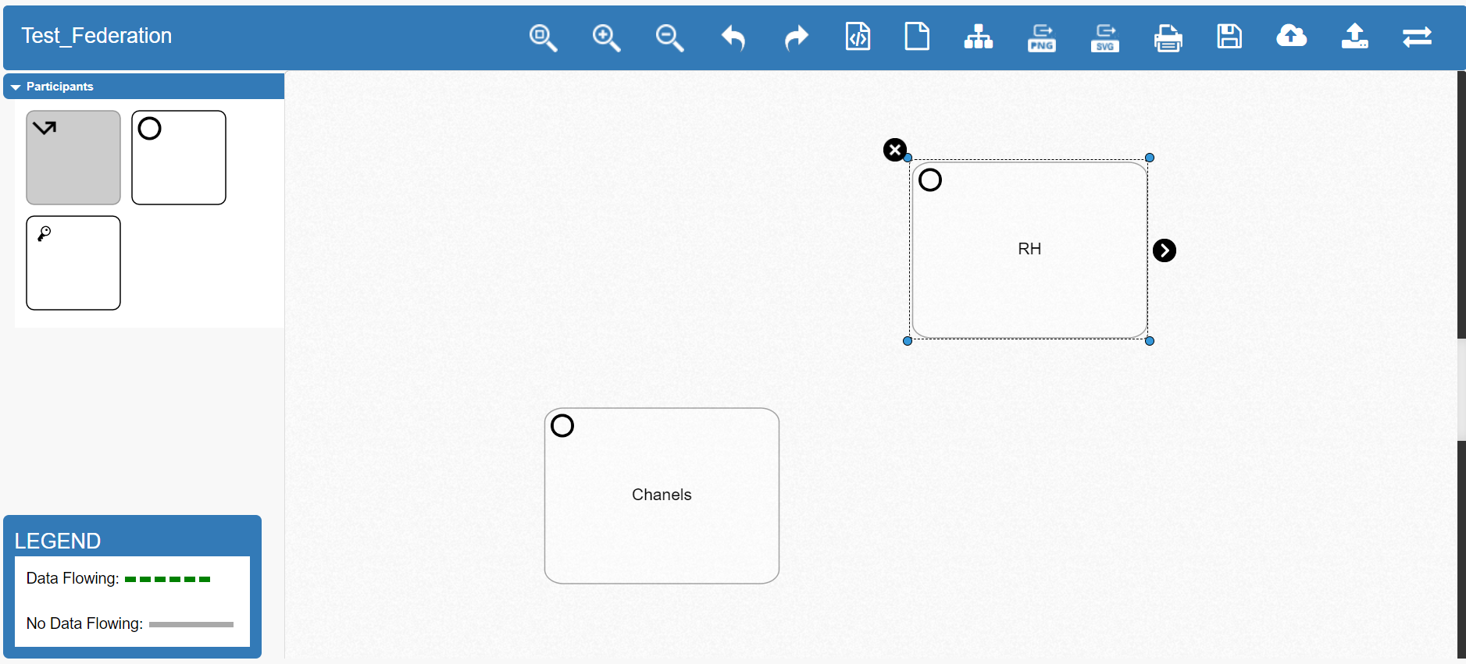
TAK Server - Federation Hub - How to Use
Repeat the previous steps to add an additional CA.
If done correctly it should look like →
Note: You can also add individual federates too the policy using the federates identity but it is not recommended.

Slide 20
TAK Server - Federation Hub - How to Use
To connect CA Groups, click on either of the groups once to select it, showing a small arrow icon on the right of the select group.
Click and drag the icon to anther group to connect them both, which will open a form “Add Federate Policy”
From here, group filtering can be configured for messages going from one node to another if the originator of the message has group mapping enabled on their TAK Server.
Filtering Options:
Allow All Messages: must be used for all V1 connections and any V2 connections that aren’t running group mapping.
Allowed Groups: allow any message containing one of these groups.
Disallowed Groups: block any message containing one of these groups.
Allowed and Disallowed Groups: allow messages that contains an allowed group and contains no disallowed groups.
You can double click on the connection to change the group filtering options.

Slide 21

TAK Server - Federation Hub - How to Use
To upload the policy to the Federation Hub select the “Set as Active Policy and Save to Server” icon in the top right. (cloud icon)
This will make the configuration the active policy of the Hub and save it to the policy file that is used by the Hub located at: /opt/tak/federation-hub/ui_generated_policy.json
If a certificate authority was added during a policy construction process you should restart the Federation Hub to load the latest truststore:
sudo service federation-hub restart

Slide 22
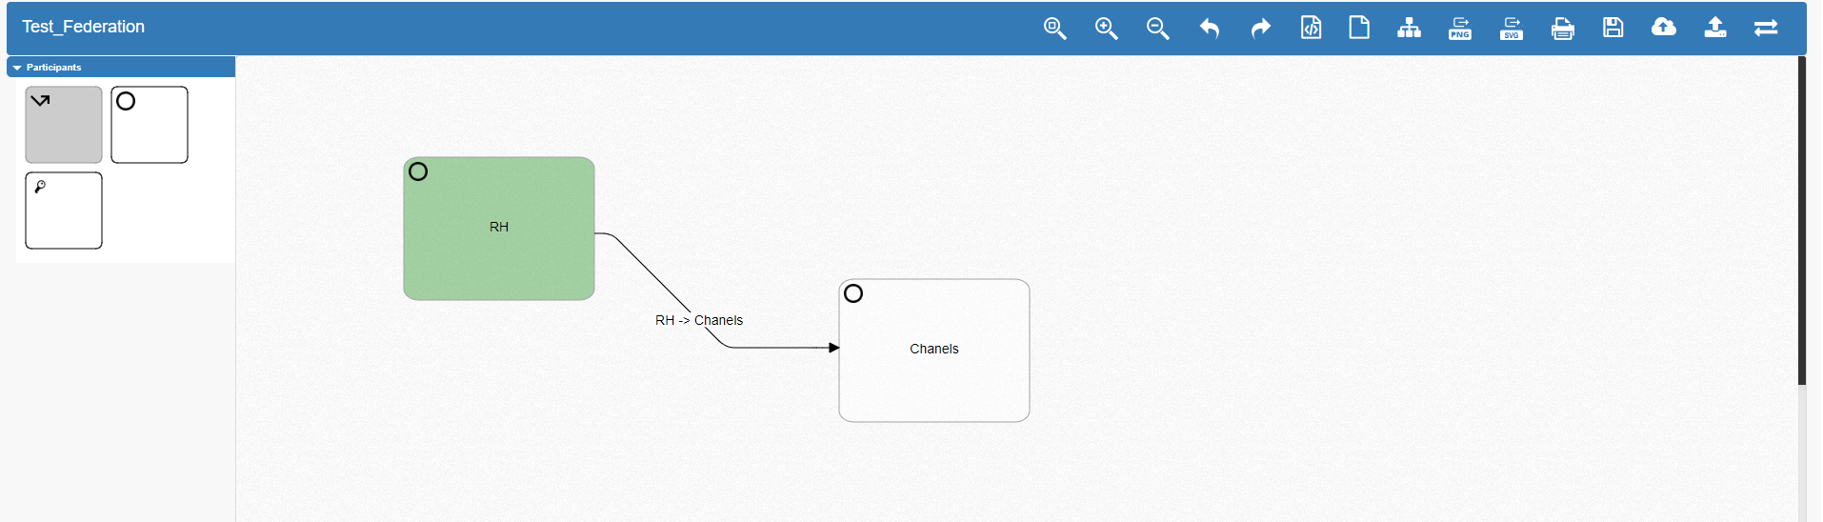
TAK Server - Federation Hub - Connecting Federates
Once the policy is configured, federates that are present in the policy can connect, while others will not be able to.
To add a federation connection to the Federation Hub you will need to use the IP address of the Hub instead of another TAK server and use the Federation Hub’s ports (9100 & 9102 for v2).
When a successful connection to the Hub is made the group node will turn green.

Slide 23
TAK Server - Federation Hub - Connection Walkthrough
Download the ca.pem certificate for the federation hub.
Server: sudo cp -v /opt/tak/federation-hub/certs/files/ca.pem .
Local: scp <username>@<ip address>:~/ca.pem .
Open your TAK Server admin dashboard and go to the following: Hamburger menu → Configuration → Federation Certificate Authority
Select “Upload Federate Certificate Authority”.
Select the file and save.

Slide 24
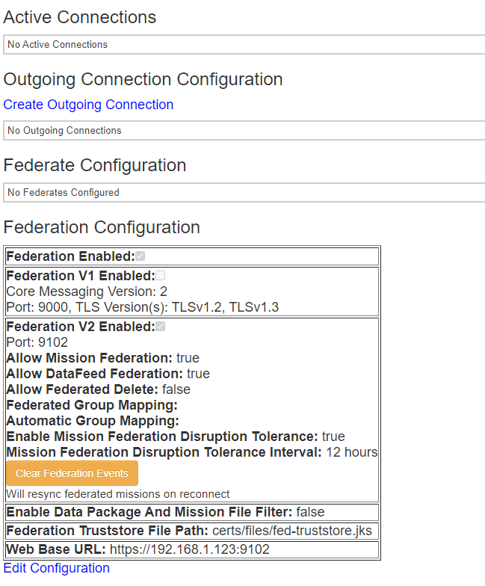
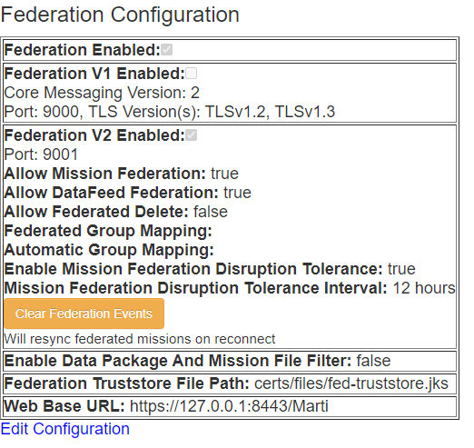
TAK Server - Federation Hub - Connection Walkthrough
Open your TAK Server admin dashboard and go to the following: Hamburger menu → Configuration → Federation
From there select “Edit Configuration” and enable “Federation Enabled:”.
Select Save at the bottom.
The page should update, and you should now see the following: →

Slide 25
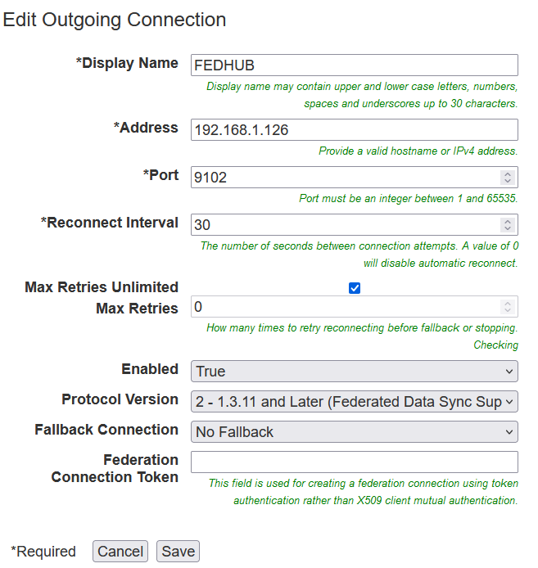
TAK Server - Federation Hub - Connection Walkthrough
From the page select “Create Outgoing Connection” and fill in the following:
Display Name: <your choice>
Address: <IP of the Federation Hub>
Port: <9100 or 9102 for V2>
Select “Save”
If all done correctly, the connection status of the outgoing connection should say “CONNECTED” and the group should be green within the Federation Hub

Slide 26
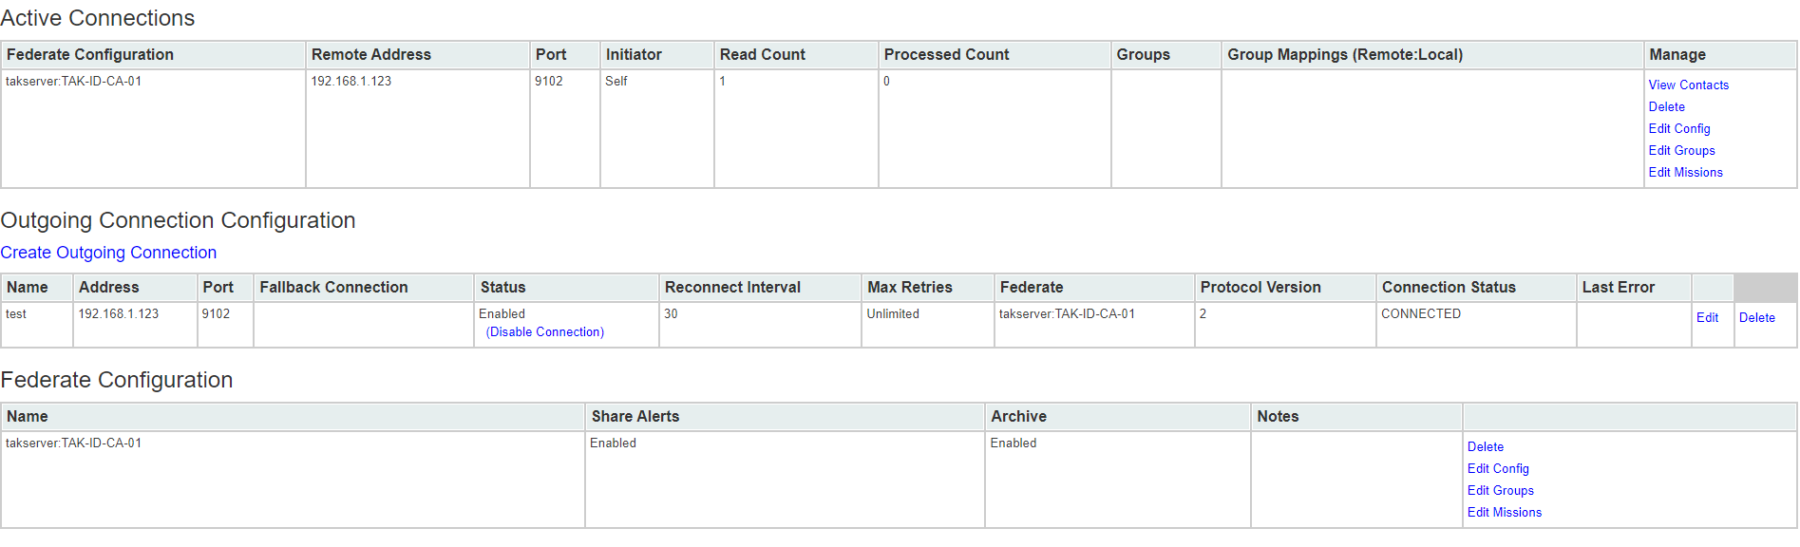
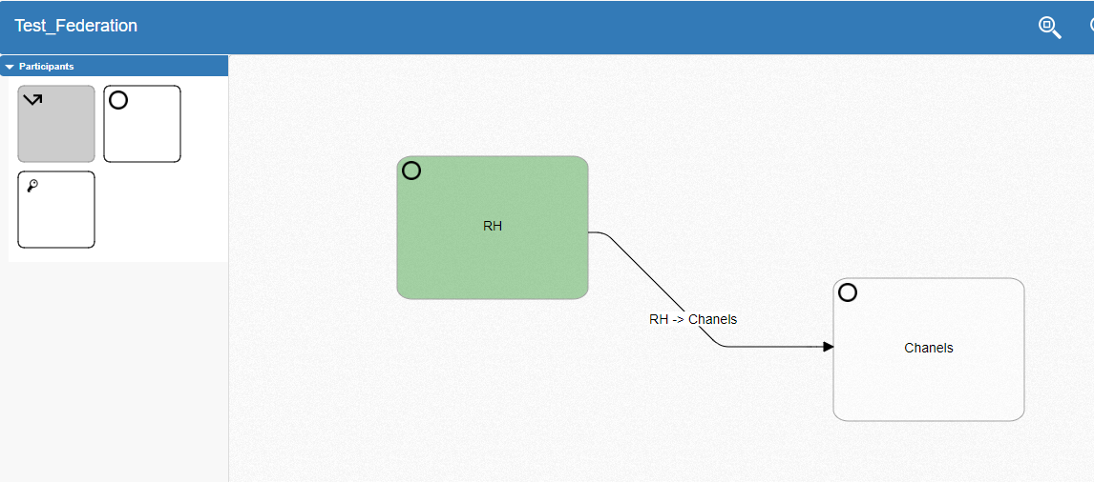
TAK Server - Federation Hub - Connection Walkthrough

Slide 27

TAK Server - Federation Hub - Outgoing Connections
An Outgoing connection can be used to connect the federation hub to other hubs or TAK Servers.
To create an Outgoing connection, drag and drop the outgoing arrow onto the graph.
Once placed, you will be prompted to give it a name, host, port and enabled option.
There are three states for the connection status:
Grey: Disabled
Red: enabled but not connected
Green: enabled and connected
To direct the flow, you can select the outgoing connection and use the arrow to connect nodes.

Slide 28
TAK Server – Updating Federation Hub
Before updating the hub, it is recommended that you back up the policy file and list of authorized users.
mv /opt/tak/federation-hub/ui_generated_policy.json /tmp
mv /opt/tak/federation-hub/authorized_users.yml /tmp
You can replace the files after the upgrade by running the following:
mv /tmp/ui_generated_policy.json /opt/tak/federation-hub/
mv /tmp/authorized_users.yml /opt/tak/federation-hub/
Update Federation Hub:
Download and copy over an update version of Federation Hub from your local machine to the server.
Run the following to update:
sudo yum upgrade takserver-fed-hub-*.noarch.rpm
Notes:
# Do you really need to download the latest version before running this?

